Slide 1
Topic 9: DEFACTO Morphing Database
Group members:
Gracy Joseph Shweta Pandey
~ M.Sc. Data and Knowledge Engineering ~

Slide 2
DESCRIPTION
We have used Morphing as a forgery category, where 2 images are warped and blended together.
Generating morphed images using ANANAS web service with respect to the genuine images from the DEFACTO database.
Visually comparing the morphed images from the DEFACTO and ANANAS web service.
Quantitative comparison:
Biometric quality - Matcher
Forensic quality - Detector

Slide 3
What is DEFACTO?
It is a novel dataset
Created by MSCOCO (Microsoft common object in context database)
The dataset contains 4 forgeries categories which are generated automatically
Copy & Move
Splicing
Object Removal
Morphing

Slide 4
Our Experiment on Images

Slide 5
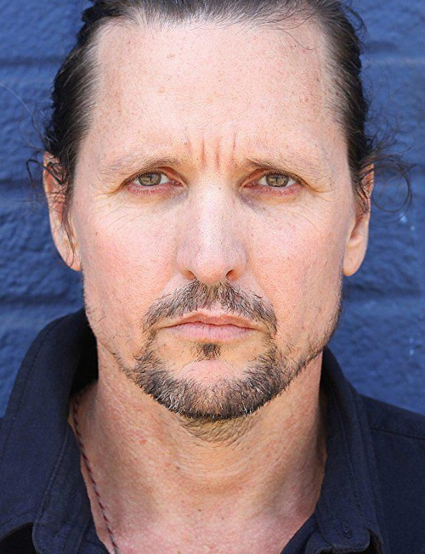
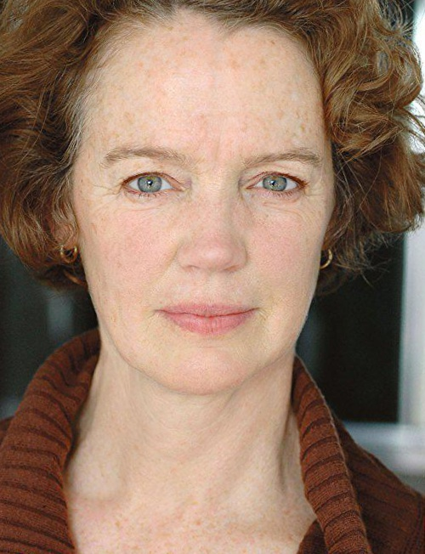
Genuine Images
Image 1
Image 2

Slide 6
COMBINED

Slide 7
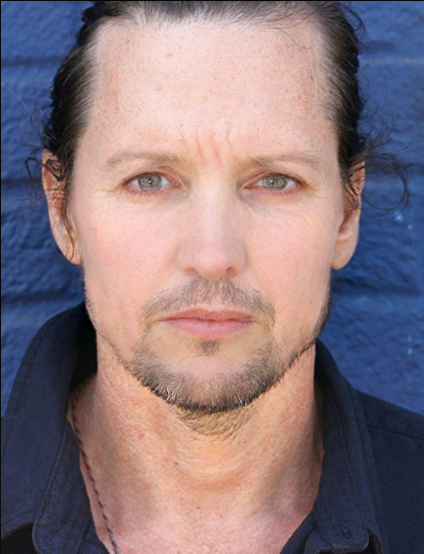
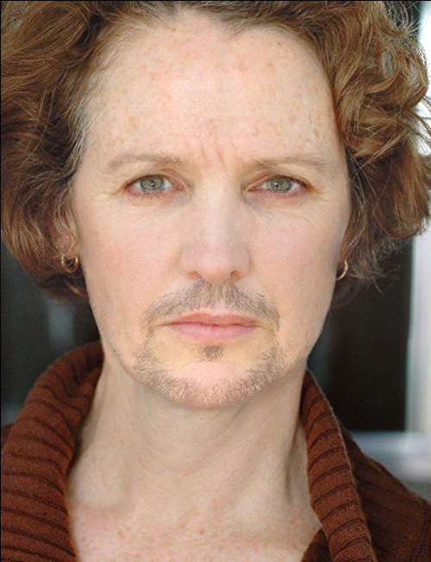
Using method ‘COMBINED’ and alpha as 0.5, we morphed the 2 images:
Image1_Image2_combined_alpha0.5
Image2_Image1_combined_alpha0.5

Slide 8
BIOMETRIC ANALYSIS
Using Dermalog Face Recognition

Slide 9
2. Using ‘MATCHER’ we could get the scores of both the genuine images with the morphed images:
Score: 99
Evaluation: Match
Image 1
Image1_Image2_combined_alpha0.5

Slide 10
2. Using ‘MATCHER’ we could get the scores of both the genuine images with the morphed images:
Score: 59.01
Evaluation: NoMatch
Image 2
Image1_Image2_combined_alpha0.5

Slide 11
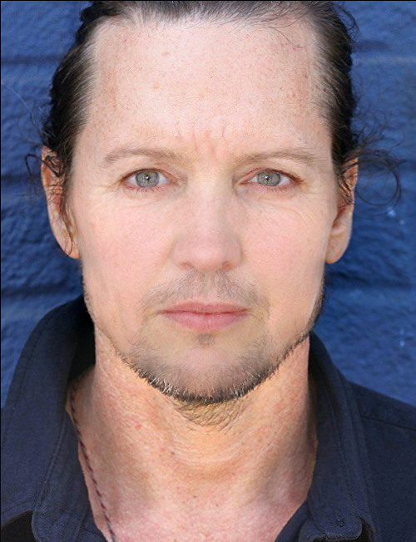
As the score was below 80 and it didn’t give a correct morphed image, we changed the alpha to 0.7:
Score: 92.64
Evaluation: Match
Image 2
Image1_Image2_combined_alpha0.7

Slide 12
2. Using ‘MATCHER’ we could get the scores of both the genuine images with the morphed images:
Score: 93.1659317017 Evaluation: Match
Image 1
Image2_Image1_combined_alpha0.5

Slide 13
2. Using ‘MATCHER’ we could get the scores of both the genuine images with the morphed images:
Score : 86.4516601562 Evaluation : Match
Image 2
Image2_Image1_combined_alpha0.5

Slide 14
FORENSIC ANALYSIS

Slide 15
3. Using ‘DETECTOR’ we could get the scores and if the images were morphed or no:
Parameters | Score | Evaluation
Keypoints, OvGU | 0.56 | Morph
GoogLeNet-based, HHI | 0.99 | Morph
Benford, OvGU | 0.53 | Morph
Degradation, OvGU | 0.97 | Morph
VGG19-based (naive), HHI | 5.08 | NoMorph
VGG19-based (multi-class), HHI | 0.01 | NoMorph
High-Dim LBP, IPK | 3.00 | NoMorph
Image1_Image2_combined_alpha0.5

Slide 16
3. Using ‘DETECTOR’ we could get the scores and if the images were morphed or no:
Parameters | Score | Evaluation
Keypoints, OvGU | 0.63 | Morph
GoogLeNet-based, HHI | 0.99 | Morph
Benford, OvGU | 0.53 | Morph
Degradation, OvGU | 0.96 | Morph
VGG19-based (naive), HHI | 3.54 | NoMorph
VGG19-based (multi-class), HHI | 0.00 | NoMorph
High-Dim LBP, IPK | 3.00 | NoMorph
Image2_Image1_combined_alpha0.5

Slide 17
COMPARISON
ANANAS web service
Combined method
DEFACTO dataset
Morphed image 1
Morphed image 2

Slide 18
SPLICING

Slide 19
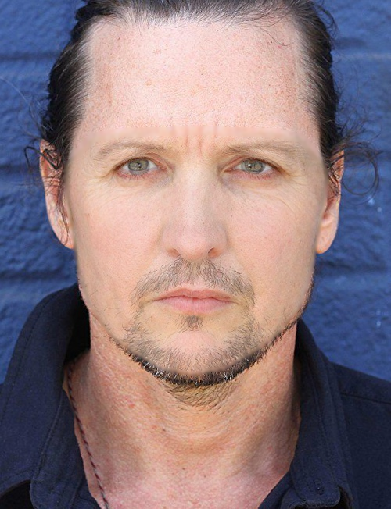
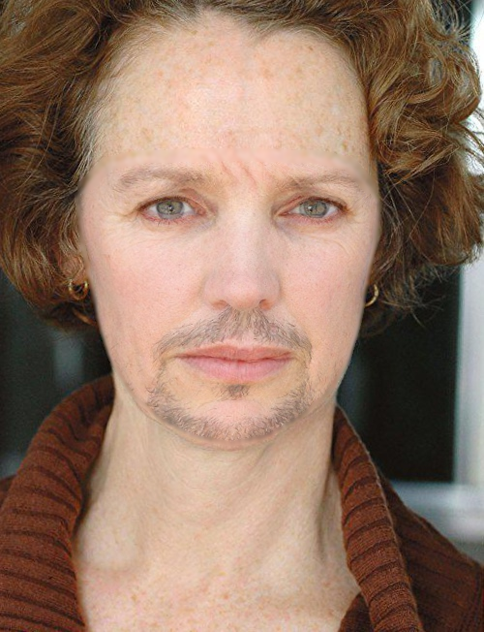
1. Using method ‘SPILICING’ and alpha as 0.5, we morphed the 2 images:
Image1_Image2_splicing_alpha0.5
Image2_Image1_splicing_alpha0.5

Slide 20
BIOMETRIC ANALYSIS
Using Dermalog Face Recognition

Slide 21
2. Using ‘MATCHER’ we could get the scores of both the genuine images with the morphed images:
Score: 99
Evaluation: Match
Image 1
Image1_Image2_splicing_alpha0.5

Slide 22
2. Using ‘MATCHER’ we could get the scores of both the genuine images with the morphed images:
Score: 39.67
Evaluation: NoMatch
Image 2
Image1_Image2_splicing_alpha0.5

Slide 23
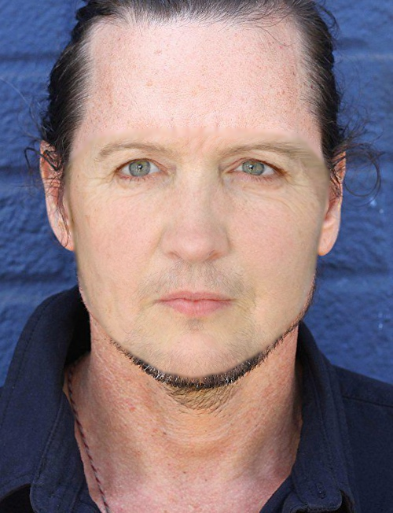
As the score was below 80 and it didn’t give a correct morphed image, we changed the alpha to 0.8:
Score: 82.01
Evaluation: Match
Image 2
Image1_Image2_splicing_alpha0.8

Slide 24
2. Using ‘MATCHER’ we could get the scores of both the genuine images with the morphed images:
Score: 86.55
Evaluation: Match
Image 1
Image2_Image1_splicing_alpha0.5

Slide 25
2. Using ‘MATCHER’ we could get the scores of both the genuine images with the morphed images:
Score: 88.99
Evaluation: Match
Image 2
Image2_Image1_splicing_alpha0.5

Slide 26
FORENSIC ANALYSIS

Slide 27
3. Using ‘DETECTOR’ we could get the scores and if the images were morphed or no:
Parameters | Score | Evaluation
Keypoints, OvGU | 0.25 | NoMorph
GoogLeNet-based, HHI | 0.99 | Morph
Benford, OvGU | 0.50 | Morph
Degradation, OvGU | 0.94 | Morph
VGG19-based (naive), HHI | 5.16 | NoMorph
VGG19-based (multi-class), HHI | 0.04 | NoMorph
High-Dim LBP, IPK | 3.00 | NoMorph
Image1_Image2_splicing_alpha0.5

Slide 28
3. Using ‘DETECTOR’ we could get the scores and if the images were morphed or no:
Detector methods | Score | Evaluation
Keypoints, OvGU | 0.32 | NoMorph
GoogLeNet-based, HHI | 0.99 | Morph
Benford, OvGU | 0.53 | Morph
Degradation, OvGU | 0.46 | NoMorph
VGG19-based (naive), HHI | 1.73 | NoMorph
VGG19-based (multi-class), HHI | 0.01 | NoMorph
High-Dim LBP, IPK | 3.00 | NoMorph
Image2_Image1_splicing_alpha0.5

Slide 29
COMPARISON
ANANAS web service
Splicing method
DEFACTO dataset
Morphed image 1
Morphed image 2

Slide 30
Literature research
Paper:
In this paper ‘ ‘ a new publicly available DEFACTO dataset is been used for the study of image manipulations
Below are the other approaches mentioned in the paper:
DATASETS | Approaches
Columbia Gray Dataset | Used ‘Splicing’ method (images were only in grayscale)
Columbia Color Dataset | Extended version
CASIA V1.0 & V2.0 | Larger dataset with more realistic tampering Used Splicing and Copy-Move methods
MICC, IMD, CoMoFoD, COVERAGE, GRIP, FAU | These are the datasets which used only ‘COPY-MOVE’ method
Wild Web Dataset | 1st to introduce real world tampered images
PS- Battle Dataset | Images were collected from active Reddit thread Photoshop Battles Creates best manipulated photo from an image Long lasting benchmark dataset and will keep growing with Reddit community

Slide 31
Current Approach (Other related work)
- Current research shows how far AI image generation has advanced.
- Paper ‘A Style-Based Generator Architecture for Generative Adversarial Networks (GAN)’ which is the work of the researches from Nvidia describes modifying the basic GAN architecture to create doctored images.
- In this work they have incorporated a method known as style transfer into GAN, in which the characteristics of one image are blended with another and it allowed them to customize faces to an impressive degree.
- It offers much higher quality than the traditional GANs and covers considerably wider variation than existing high resolution datasets.
Traditional methods of GANs had below issues which was worked upon by style transfer literature.
Understanding of various aspects of synthesis process eg. Origin of stochastic features (eg. Freckles, hair) was lacking
Properties of latent space were poorly understood
Latent space interpolations provide no quantitative way
No strengthening of image features at different scales

Slide 32


